Slide 1
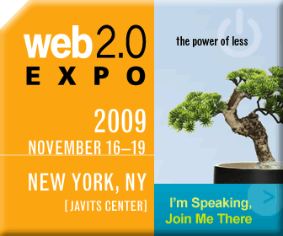
Marketing via Fan Boys/Girls: Your Customers As Your
Brand Evangelists
Notes:
Power of less – pebble in a pond
*Don’t have to convince you
Companies at various ends of spectrum
unleash the power of the people
think maybe their industry doesn’t apply.
Hopefully there is something of value here from each end
Little about me
Web 1.0 cred (not a blogger since 1991)
Expedia – social media strategy
Start-up Bevy
Picnik
Then picnik slide

Slide 2
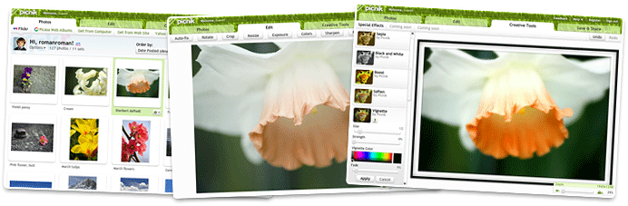
Picnik
Photo-editing Awesomeness
Notes:
Fun, Easy, Robust
Freemium Model
Social Hooks – Flikr, FB, MySpace, Twitter, Yahoo!Mail, Photobucket, etc
Across all cultures, Photos are the single most provocative, beguiling, yet simple means of conveying a wide range of human experiences; our emotions, identities, and what/whom we care most about. It’s a common denominator across all cultures
Yet, for most people the ability to affect the photos themselves; to enhance, to embellish, to EDIT is largely inaccessible. Its either too expensive, too hard to use, or both.
We at Bitnik are dedicated to the mission of giving the average everyday consumer photo-editing superpowers, and to make these photo-editing powers super easy. We want my mom to be able to use it, and to feel they are always just 1 or 2 clicks away from… Furthermore to do so all you need is a browser, no download, no install process.
It’s our notion of ‘Great Pictures. Anywhere. Anyone’.

Slide 3

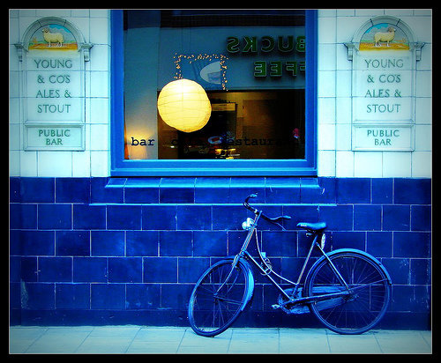
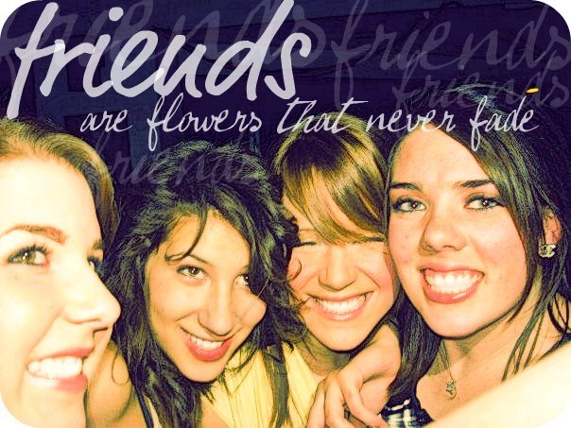
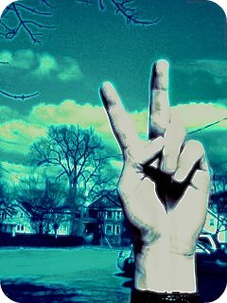
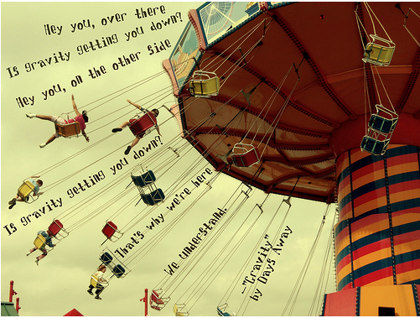
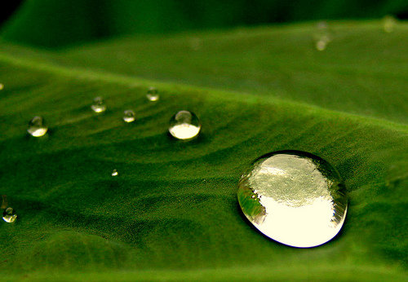

Notes:
Across all cultures, Photos are the single most provocative, beguiling, yet simple means of conveying a wide range of human experiences; our emotions, identities, and what/whom we care most about. It’s a common denominator across all cultures
Yet, for most people the ability to affect the photos themselves; to enhance, to embellish, to EDIT is largely inaccessible. Its either too expensive, too hard to use, or both.
We at Bitnik are dedicated to the mission of giving the average everyday consumer photo-editing superpowers
We want my mom to be able to use it, and to feel they are always just 1 or 2 clicks away from… Furthermore to do so all you need is a browser, no download, no install process.
It’s our notion of ‘Great Pictures. Anywhere. Anyone’.

Slide 4
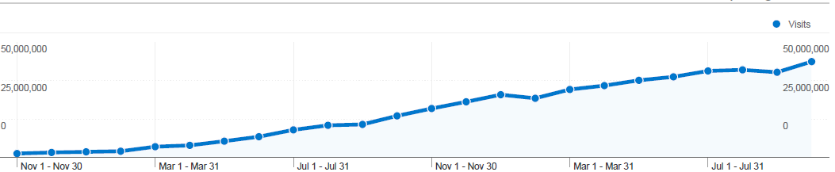
Why Picnik is a fan of fans
Launched in 2007
14+mm Uniques/Month
40+mm Visits/Month
1+mm Daily/Visits
Notes:
Picnik would not have this growth without our fans.
Press, Word of Mouth, bloggers
LESS IS MORE - We did not spend money on advertising, or build a vast marketing team yet exciting growth.
How did this happen? Fans, Fans, Fans
My job as a marketer is twofold 1) not to screw this up… 2) leverage and drive for more

Slide 5
What is a fan?
Love + Influence + Megaphone
Notes:
More than just deep like
This is an equation.
Ideally all of these will rank high
but big love and small megaphone is still good.
Moderate love but big influence and megaphone still good.

Slide 6
Give ‘em Something to Love
Brand
Product
Value/Price
Customer Service
PR/Advertising
Notes:
People are talking about you (or even worse!) so give them something to be a fan about
Traditional companies can carve out something here….

Slide 7
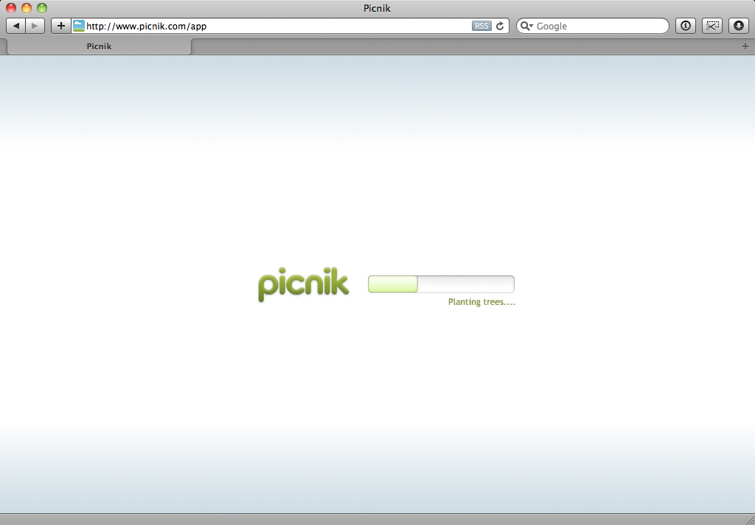

Brand
Apple
Disney
Mini Cooper
Picnik
Notes:
More than logo graphics/ essence describe like a friend.
Loading bar – chatted about a lot
Growing grass…Fluffing clouds…Warming breeze…Blooming blossoms...
Floating kites…Stealing picnik basket…Sprinkling dew…
Coloring flowers…Cueing bird songs…Painting sky…Planting trees...
Picking blackberries…Buttering sandwiches…Applying sunscreen...
Laying blanket...

Slide 8
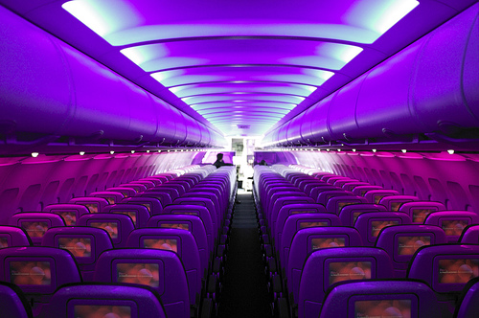
Product
iAnything
Boxee.tv
Virgin America
Picnik
Notes:
Product differences are marketing fodder
in our web 2.0 world can’t lose sight that product is part of marketing and visa versa
Picnik – Elegant UI, Easy to Use, Robust (pretty girl who is smart), FUN
Virgin – Had to choose to fly this with Wifi, touchscreen seatback, or a gray seated XX Airline HMMMM

Slide 9

Value/Price
Costco
Hotwire
Trader Joe’s
WalMart
& Picnik
Notes:
Costco – cool for suburban middle glass to shop warehouse. 10 gallons of mayonnaise $10 and a Coach purse for $80
Hotwire – stay above your expectation/budget
Trader Joes – amazing food and about 2 more bags of it (Song on YouTube)
Picnik – Freemium model. Love the Free and upgrading is still a bargain

Slide 10
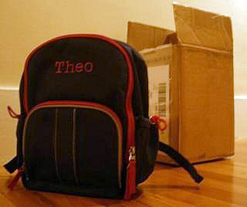
Customer Service
Southwest Airlines
Nordstrom
Zappos/Amazon
Starbucks
Yes, Picnik
  *Peter Hartlaub -The Poop blog
Notes:
Nordstrom/Zappos/Amazon return policy and shopping assistance
Starbucks – listen and act on this in menu, merchandise, etc
Picnik Feebackers - - listen / act / report back / reach out even when not contacted. If expressing problems in twitter/facebook/etc.
Southwest – Blogger Peter Hartlaub – The Poop.
Son lost backpack w/out ID
Didn’t even know where lost it so half heartedly tried – nothing important more sentimental
SW employee doggedly tracked them down after finding a receipt for a bookin the backpack. (I mean doggedly)
SW flyer for life – (megaphone)
vs. United Breaks Guitars – Dave Carroll

Slide 11
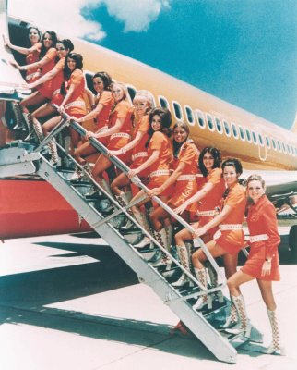
PR/Advertising
Southwest Airline
Pemco
Bacon Salt
TOMS
Notes:
Northwest Profile #3 – Regional Insurance Company with funny advertising poking fun at NW personality types.
One for One – Toms
Bacon Salt – embraces the absurd. They are salt that tastes like bacon. Daily Show Baconaise…..
Another SW exampe: MiniFare Sale – Tell story/Skimpy Fare/Deep cuts/Mini prices.
Valve _ fired guy who designed

Slide 12
Who is an influencer?
: the power or capacity of causing an effect in indirect or intangible ways
: sway
: one that exerts influence
~Merriam-Webster
Notes:
Yes these people are born but you can also create – if given info, access, etc. “wow this person really knows their stuff”
If suggested by influencer:
More willing to try,
More willing to like,
More willing to give second chance,
People will listen
People will watch
People will forgive

Slide 13
Influence the Influencers
Identify
Cultivate
Grow

Slide 14
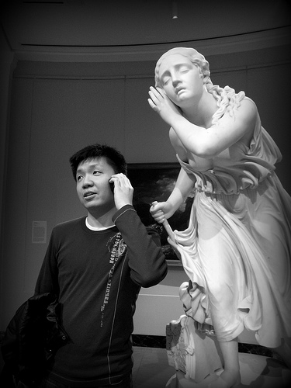
Identify – Pay Attention
Tweeting?
Commenting?
Blogging?
Giving feedback?
Recommending?
Posting?
Traffic Sources?
Notes:
Who is…

Slide 15
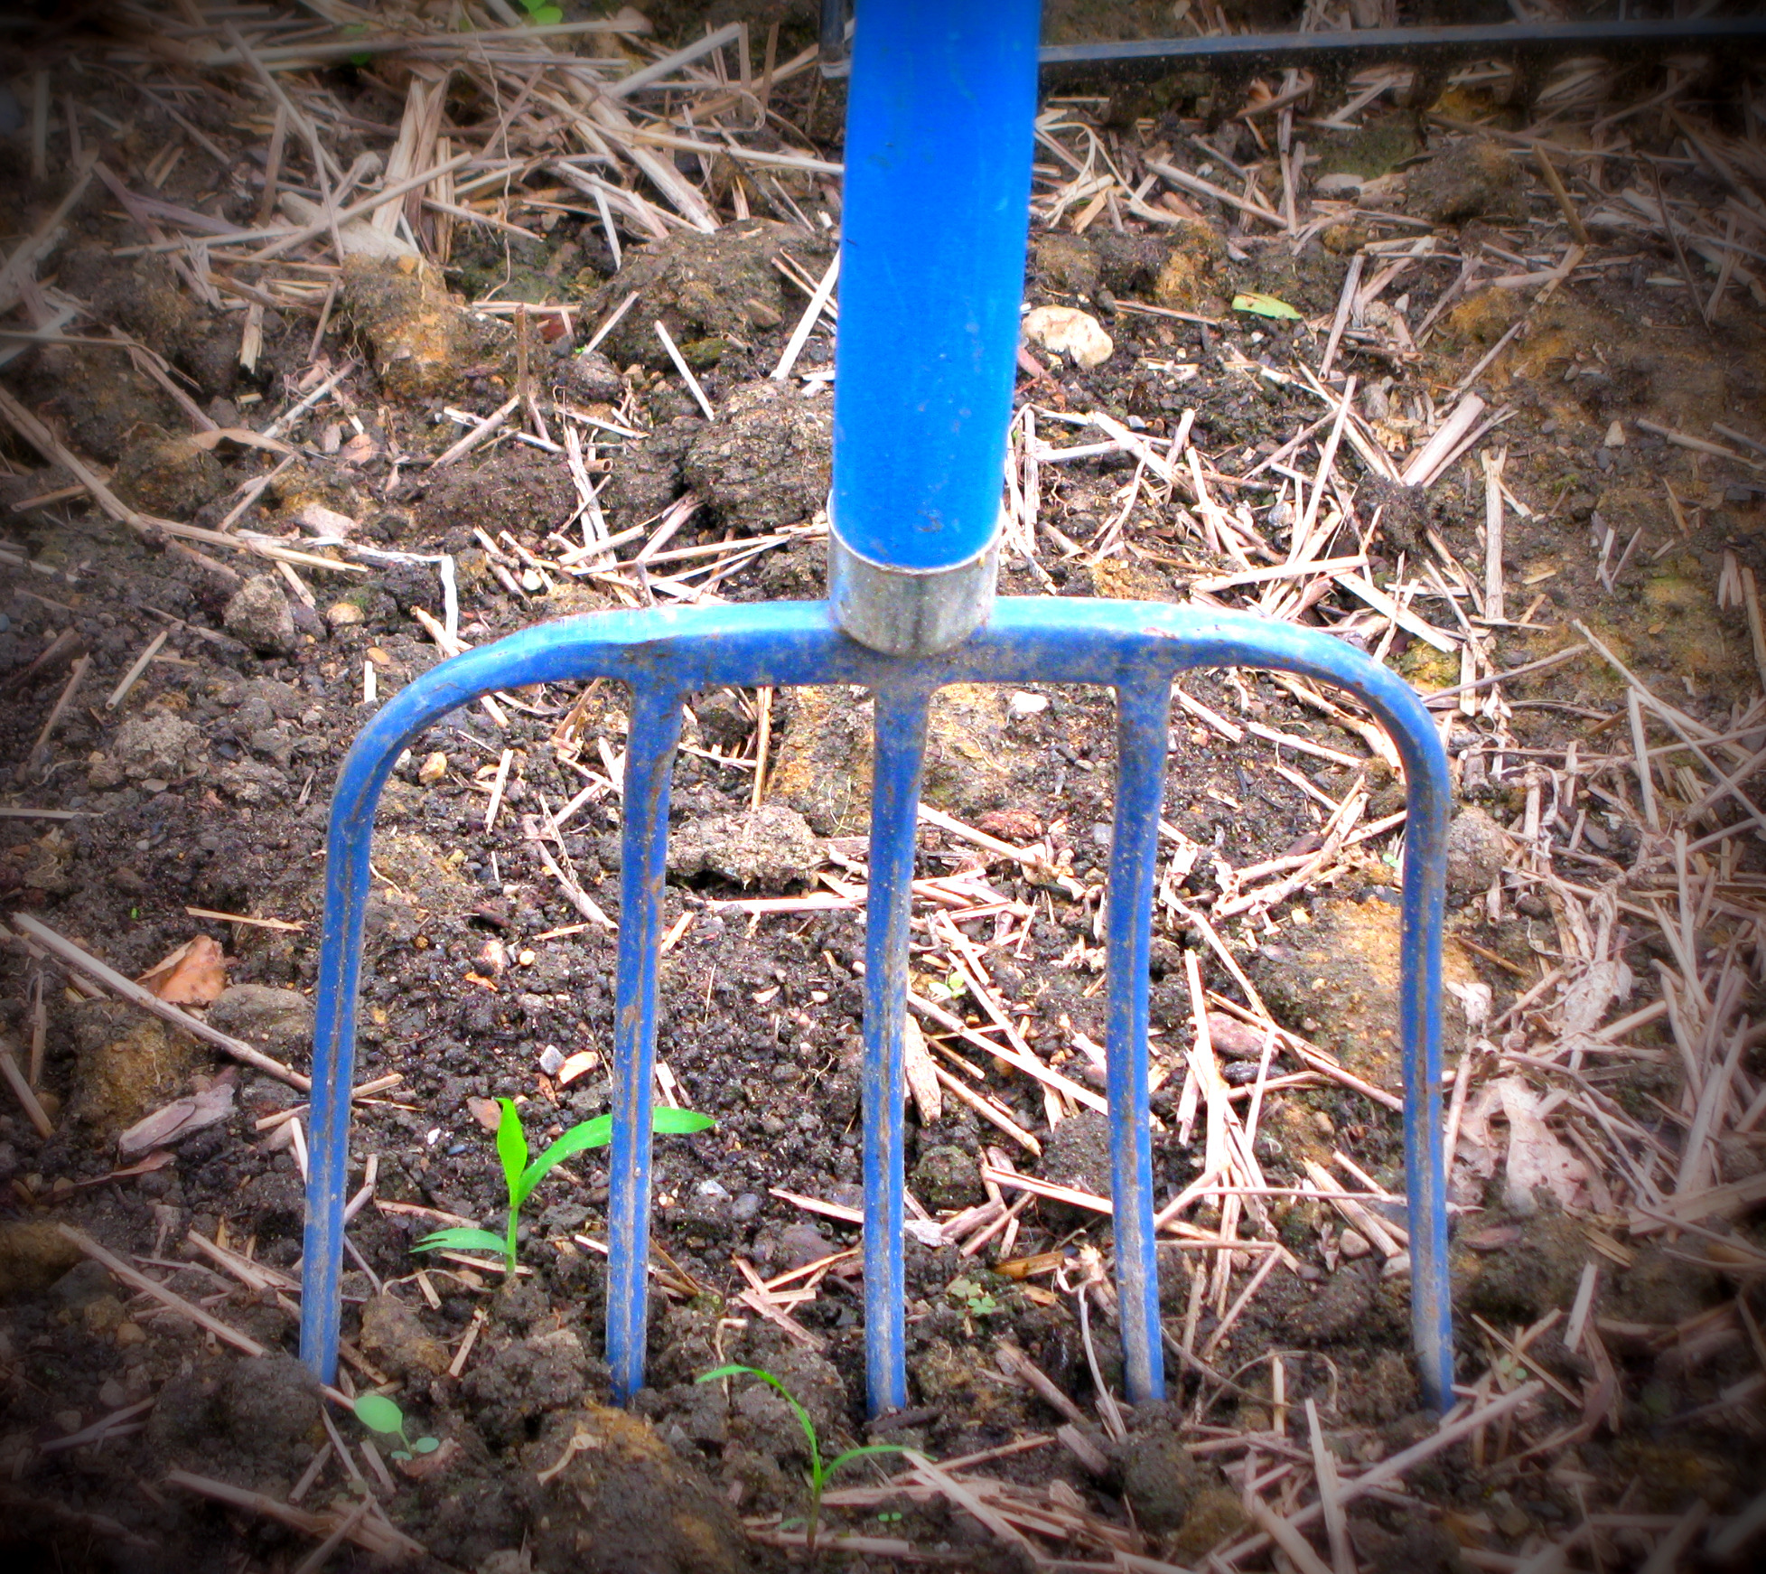
Cultivate – Make ‘em feel special
Create a fan program
Listen & let them know it
Make it personal
Thank/Acknowledge
Feed the Beast
Notes:
Fan program is too keep them engaged, - WORK IT
Benefits
Exclusive Stuff
Sneak Peeks
Thank/Acknowledge
Feed the Beast
give them ways to be influencers – giveaways?, exclusive content,
Make it personal – no form letter, let them look under the covers, let your blog be a glimpse into life
Let them know you care

Slide 16
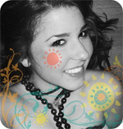

Featured Picniker - Katie
Notes:
In Facebook from day 1. Active/Engaged we noticed.
Then we started see a cluster of traffic from her town/H.S. We noticed.
So we started the Featured Picniker program and made her our first one.
Listened, Thanked, Acknowledged, Made her a hero and reason to tell more people
TopShop.com - Program of 1 Fan but paid offf

Slide 17
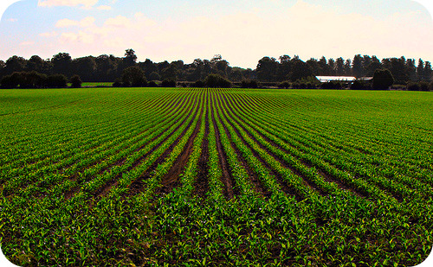
Grow – Who could be a fan?
Identify Verticals
Tap into Conversations
Introduce & Insert in a helpful way
Stay involved in the conversation
Don’t be afraid to direct them elsewhere
Notes:
Or who SHOULD be
Game company PTA programs
Toy company Mommy blogger syndicate
Picnik - Flickr Fan

Slide 18

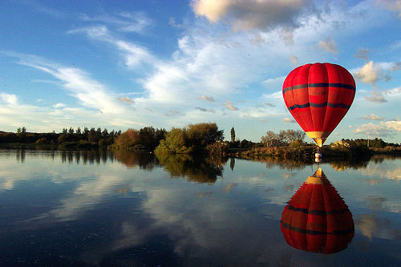
Curious Kiwi - Brenda
Notes:
Listened:
* She was in the photography vertical
* She was already tapped into conversations
* Introducing information in an authentic, authoritative way (she is well regarded & influential)
* Answering questions, talking about Picnik
* Constant part of conversation, initiatives conversations as well, active in other places as well
Cultivated
We hired her –
Brought her on staff and asked her ramp up the conversation.
Monitors chatter inside Flikr, Created/Moderates Flikr’s Picnik group, runs contests, answers questions, shows inspiration
Grow
It’s a loop she is now listening, cultivating and growing

Slide 19
Megaphone – Need to be heard
Ideal if have a big voice already
Provide an outlet
Make it easy to share
Provide the content
Make them a hero
Notes:
Brenda example of high influencer, Picnik love and Flickr group provided megaphone
Faciliate the conversation
** Facebook provides megaphone,
** Twitter provides megaphone, send your fans into events/conferences give them a megaphone
Provide outlet (on your own site or a community off-site via wetpaint ex)
Easy – retweet
Go where are – Facebook? Allows posts/content carries in their feed
Content - Contests, tutorials, trends
Bloggers/
If you make them a hero they will acquire a bigger megaphone…

Slide 20
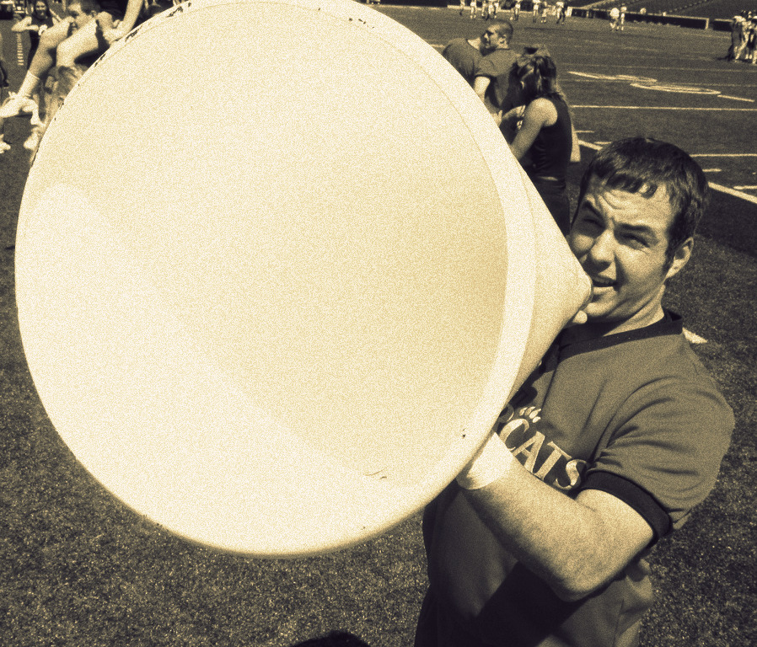
Love + Influence + Megaphone
+ Embrace - Control
Notes:
Give them something to love
Find Influencers or create them
Find a megaphone or give them one
For extra fan credit –
Embrace the absurd, Embrace the unconventional
Let go ,
Let Go – Your fans will not always be “on message” but it will be more targeted and authentic to their audience and influencees than you ever can be
Let Go – they aren’t going to follow your corporate talking points and follow your pre-determined message hierarchy. They are going to rave about what is important to them and their tribe – this may not even be on your list of main messages but it will reasonate more deeply and therefore be more effective. Also don’t be afraid to jump in and lend assistance if something is just dead wrong.

Slide 21
Thank - you
Notes:
My job title is CMO/Bullhorn
I am starting here. You guys are influencers and I would love for you to be fans. Grab me after session for a complimentary upgrade.

